Slide 1
Midterm Idea
By Carlos Izaguirre

Slide 2
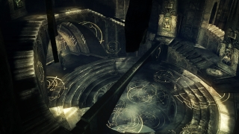
Main Focus
Creating a VR experience that focuses on the user’s movement and view of the world. This will be done by incorporating a variety of environments tied together by a central hub.

Slide 3
The central hub will use paintings as the way to travel between different worlds, similar to how Mario 64 handles its worlds. I also plan to use a camera to “interact” with the paintings by having the player move them towards their head live how The Lab does it.
It will contain:
A big center with space to grow accustomed to the controls
A testing area to play around with items found in the various worlds
Paintings showing a picture of a part of the world traveling to
A plaque describing the world and/or its function

Slide 4
The worlds will have their own “mechanic” that makes them unique
These may include:
Combat
Shields, swords, spears, etc.
Minigames
Shields - parrying projectiles, Bows - shooting targets, Small puzzels

Slide 5
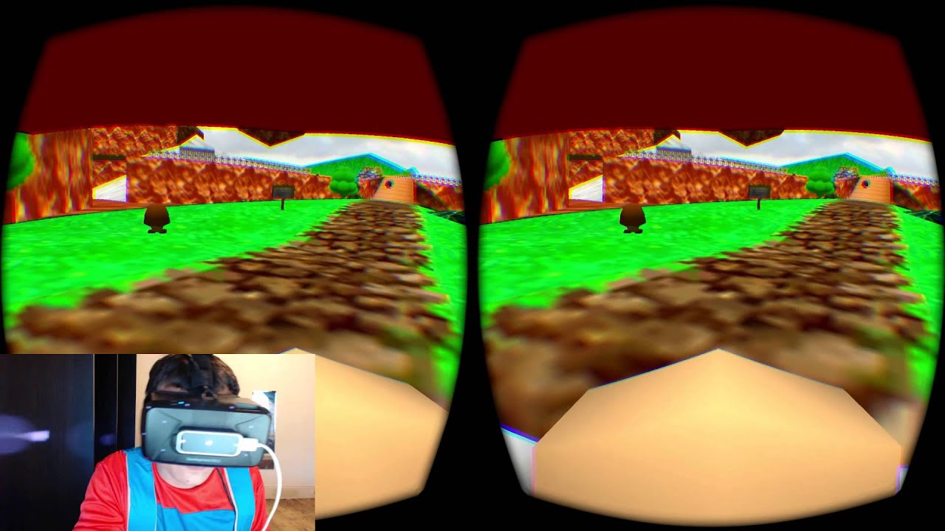
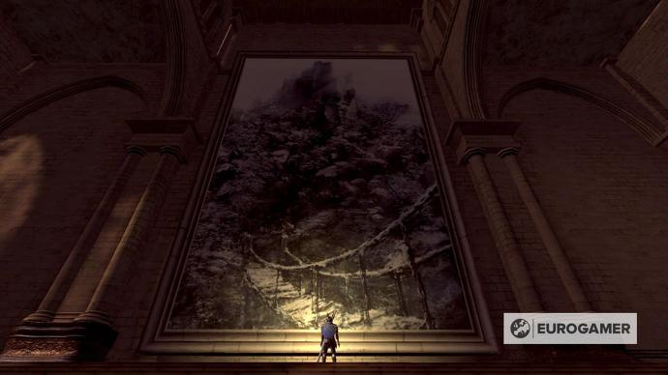
Inspiration
The idea of the hub and this means of moving between scenes came from Mario 64, Dark Souls, and Demon Souls
Mario 64 has a hub that uses paintings to move to other worlds, and Dark Souls and Demon’s Souls have a nice aesthetic and design to their central hub along with a painted world accesses through a painting.
I will be using the Mario 64 VR port by Kaze Emanuar as reference. I will also be using The Lab by Valve as a reference.

